Slide 1

NAME: DAIDIPYA NAYAN JADHAV NAME: DRASHTI PATEL
ARDUINO :
LIE DETECTOR

Slide 2
INSTRUENTS USED IN LIE DETECTOR
> Arduino – Uno. > Green led.
> Breadboard. > Potentiometer.
> Piezo speaker. > Lcd Screen - 16*2.
> Red led. > 560 ohm Resistor.
> White led. > Jumper Wires.

Slide 3
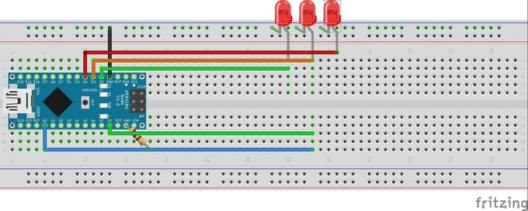
LIE DETECTOR BY DANTE ROUMEGA

Slide 4
INSTRUMENTS BY DAIDPYA AND DRASHTI

Slide 5
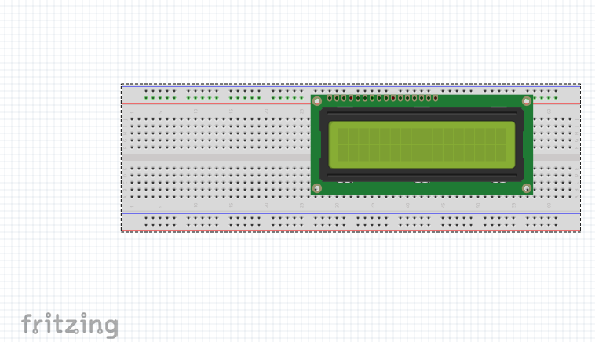
LCD 16*2

Slide 6
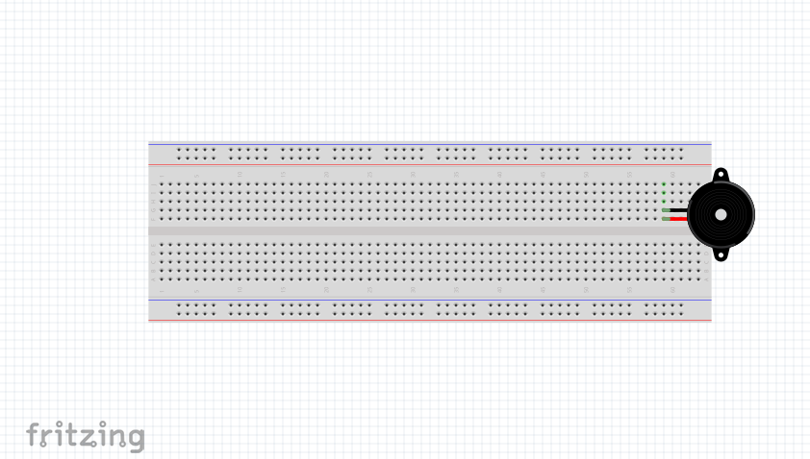
PIEZO SPEAKER

Slide 7
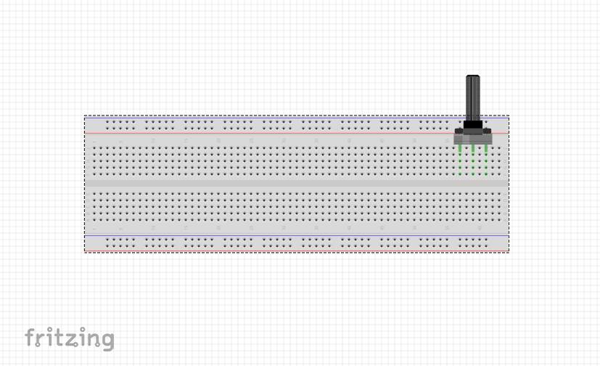
POTENTIOMETER

Slide 8
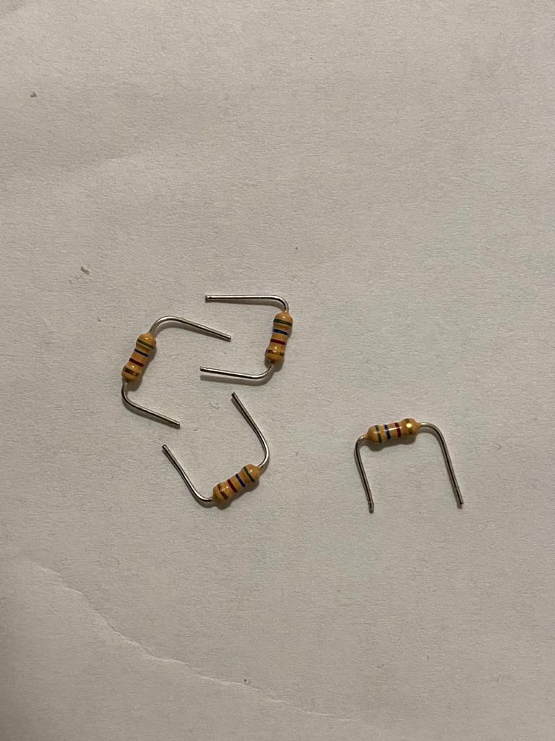
560 OHM RESISTORS

Slide 9
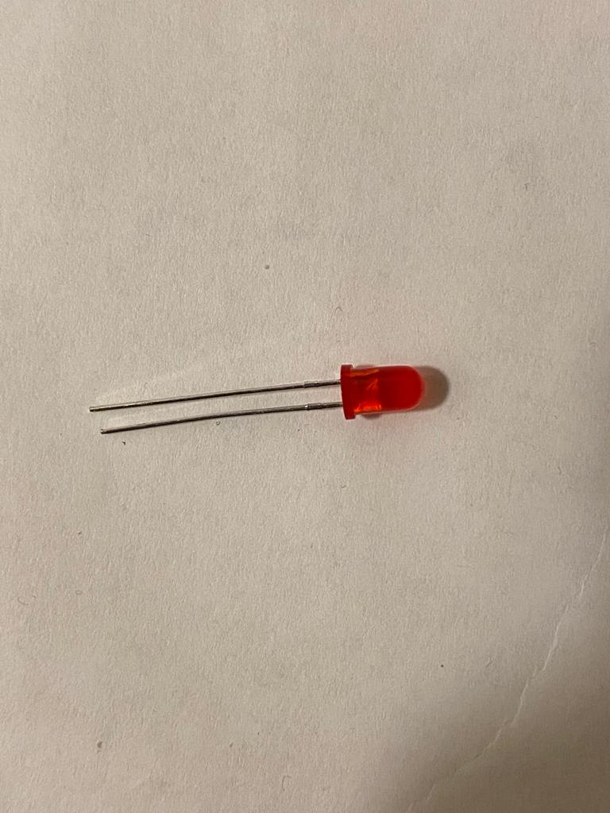
RED LED

Slide 10
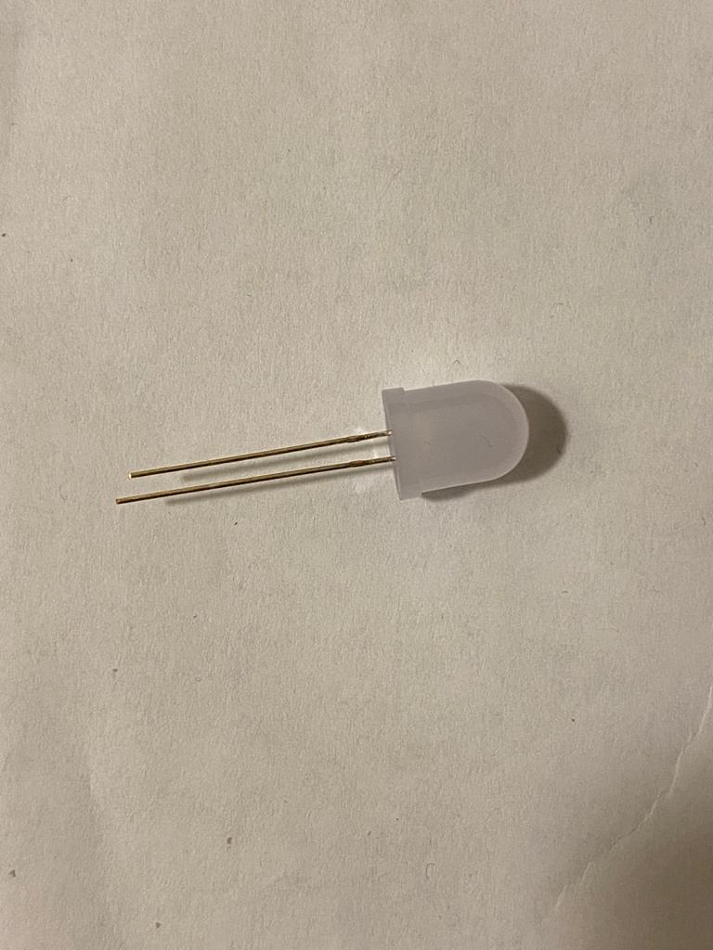
WHITE LED

Slide 11
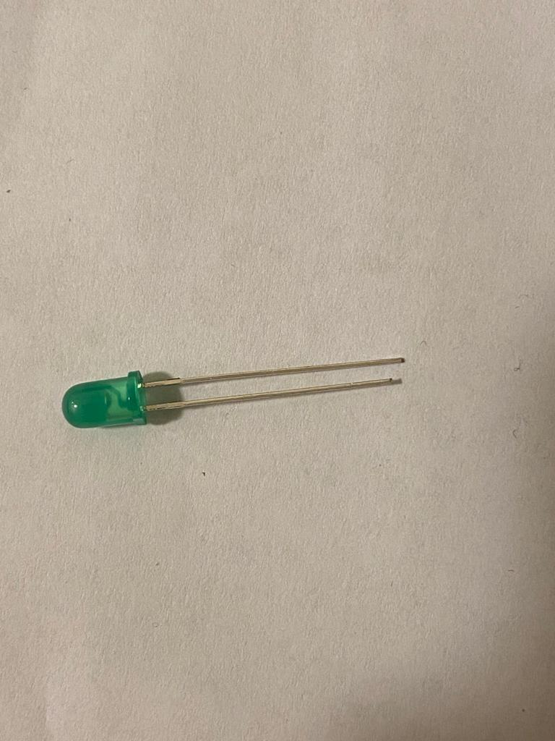
GREEN LED

Slide 12
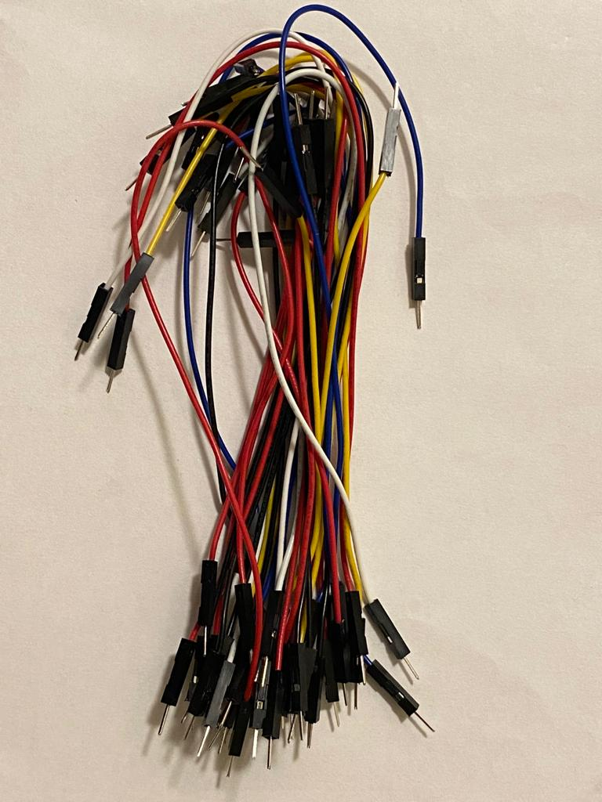
JUMPER WIRES

Slide 13
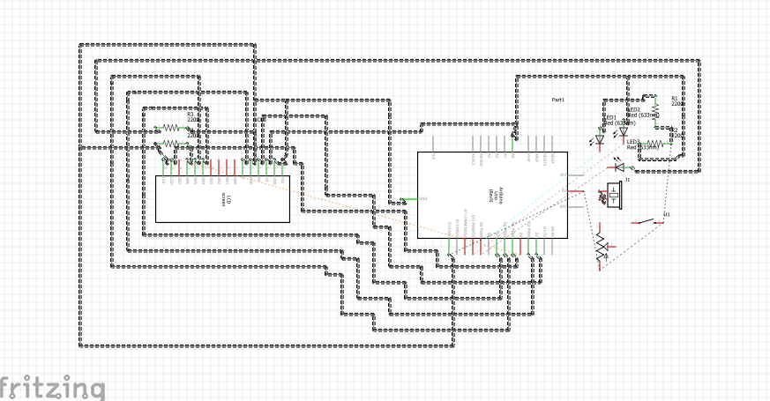
SCHEMATIC DIAGRAM

Slide 14
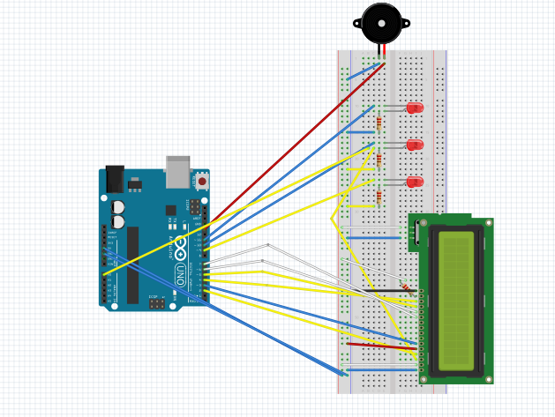
LIE DETECTOR BY OUR GROUP

Slide 15
INFORMATION ON THE FRITZING
In the previous slide I have provided my kind of lie detector.
I have used red led instead of white and green but the functions and working will remain same as well as the resistors I used are of 220ohm in fritzing instead of 560ohm.
I will provide a picture of my proper project in the next slide.

Slide 16
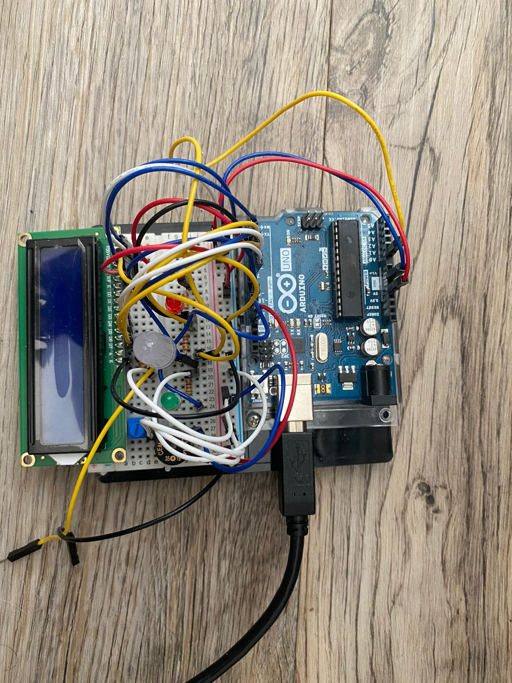
HARDWARE

Slide 17
THANK YOU

